Slide 1
SQL Plus
Command line interface into Oracle Database
Comes with installation of Oracle Client Software
Located on development server trdx-odt01 in E:\oracle\MWare\Oracle_FRHome1\bin\sqlplus.exe
Create shortcut for each account/database used

Slide 2
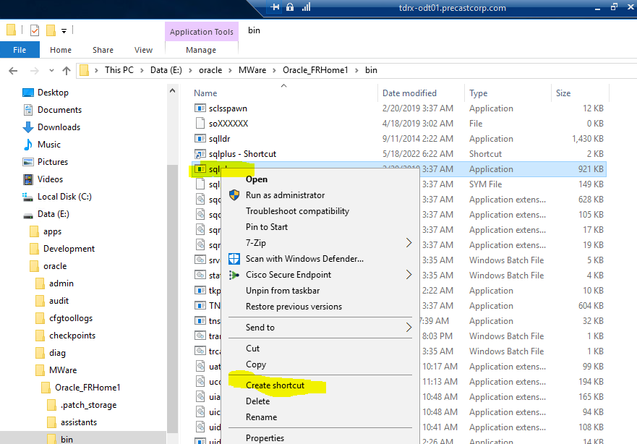
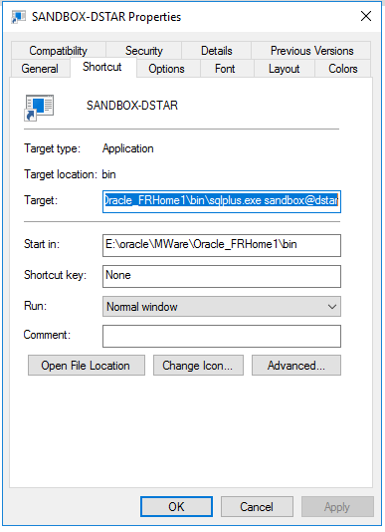
Create Shortcut on sqlplus.exe Edit Target Properties Append account_name followed by @ followed by database name Example below the value ‘sandbox@dstar’ was appended to the target Optionally you can specify the password syntax = account_name / password @ database Create Folder on Desktop to hold your SQLPlus shortcuts

Slide 3
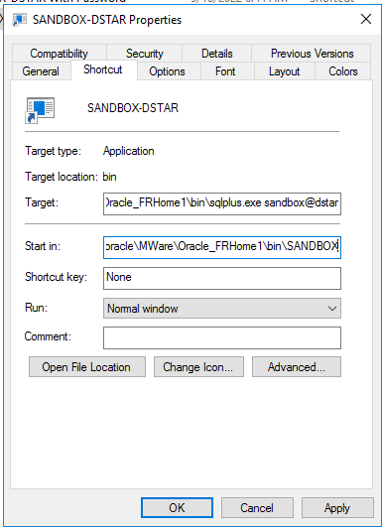
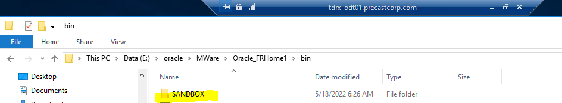
Create working directories under BIN Modify Start In Property of SQLPlus Shortcut
Example below shows directory of SANDBOX and setting shortcut Start in property
*This is done to specify the directory where to run scripts from without needing to qualify the directory name.

Slide 4
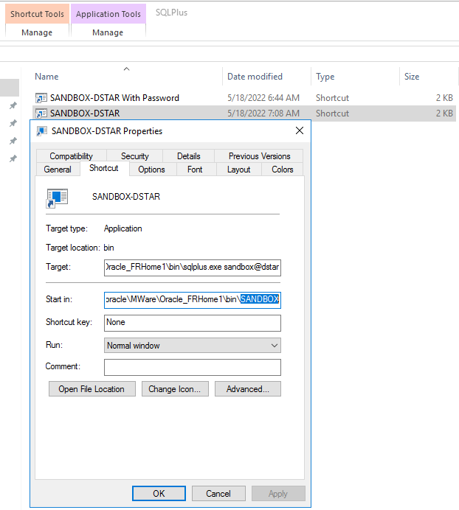
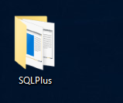
Sample SQLPlus Desktop Folder optional to hold different SQL Plus Shortcuts

Slide 5
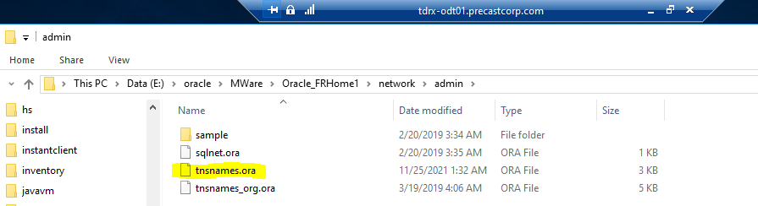
Connection Information for Oracle Client
TNSNAME file contain the connection information for each database. When a new database connection is needed, this file needs updating
File is located in the network/admin folder of the Oracle Client Home
For trdx-odt01 development server the path is
E:/oracle/MWARE/Oracle_FRHome1/network/admin

Slide 6
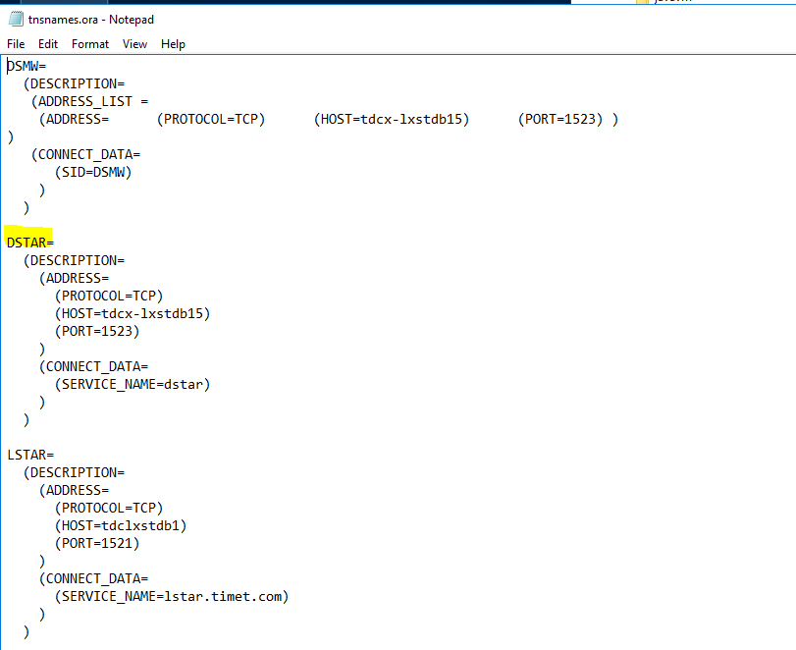
tnsnames.ora file

Slide 7
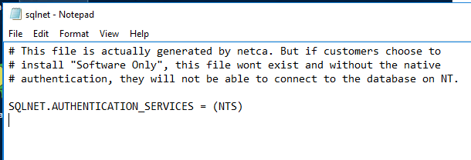
Sqlnet.ora
This is another file that is less frequently updated for connections
This file along with tnsname.ora are used to connect SQLPlus and other products using the Oracle Client to an Oracle Database

Slide 8
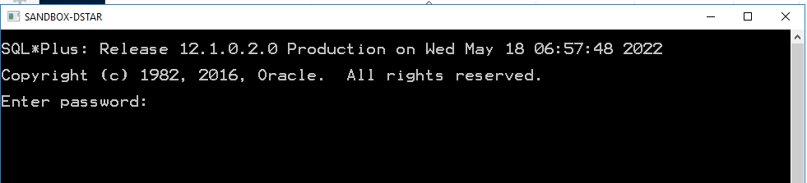
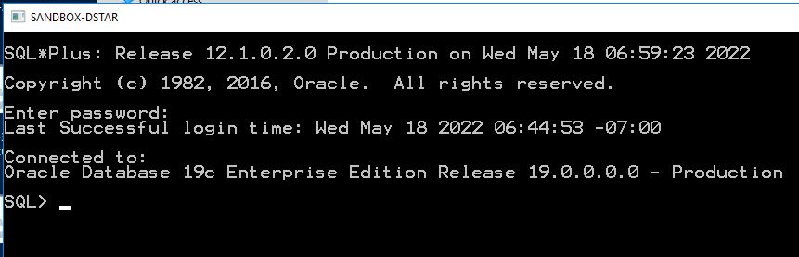
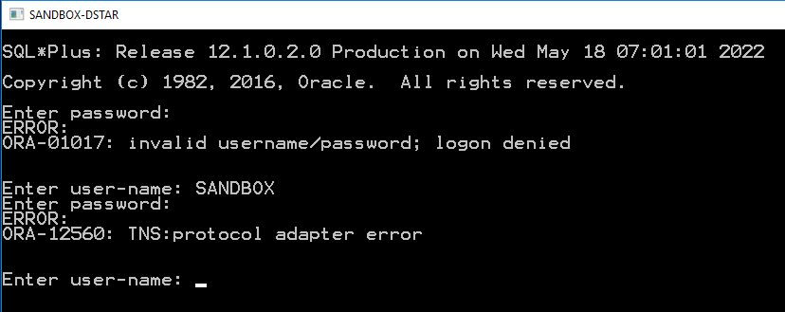
Example starting session with Shortcut
Double click Shorcut
Enter Password
Note if you enter incorrect password, exit and start over. Otherwise it errors out

Slide 9
SQLPlus Commands
SET SERVEROUTPUT ON ← Needed to view DBMS_OUTPUT
SET SERVEROUTPUT OFF
SET DEFINE OFF
SET DEFINE ON
Link to Oracle Site with all SQLPlus Commands
SQL*Plus Commands (oracle.com)

Slide 10
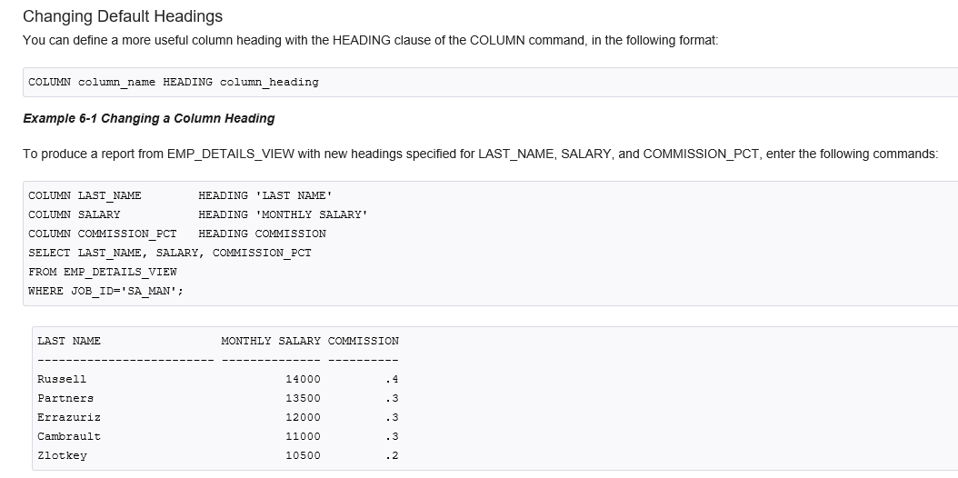
SQLPlus Report Formatting 1 of 2
Link to Website describing SQLPlus Report Formatting
https://docs.oracle.com/cd/B19306_01/server.102/b14357/ch6.htm

Slide 11
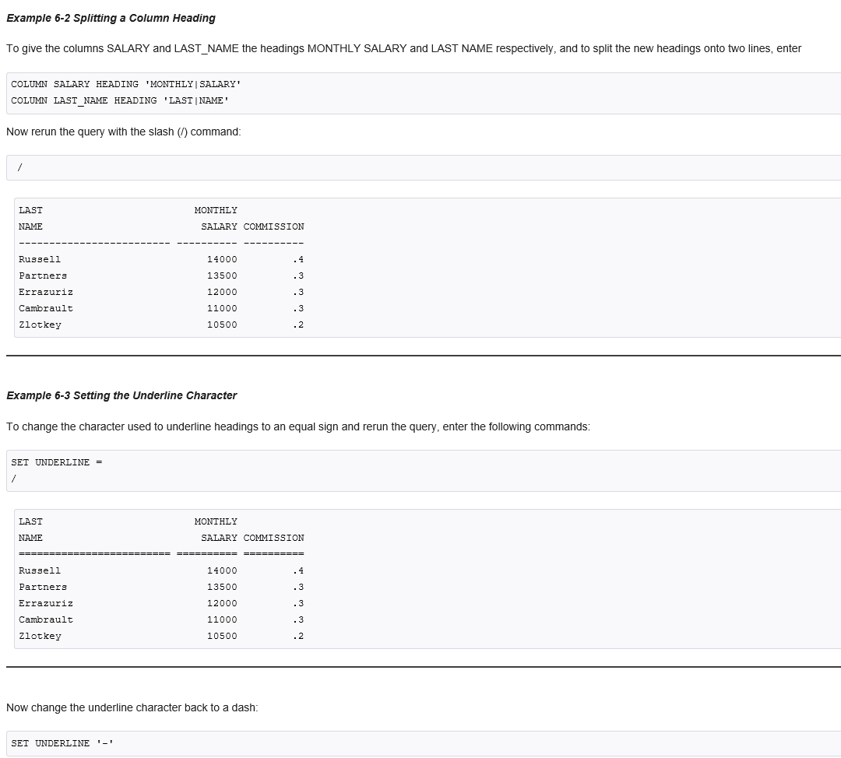
SQLPlus Report Formatting 2 of 2

Slide 12
SQLPlus Formatting Example Script
-------------------------------------------------------------------------------
-- Filename: EMPLOYEE_REPORT.sql --
-- Author: Jim Slanker --
-- Date: June 1st, 2022 --
-- Queries the XXJS_EMPLOYEES table Report Format --
-------------------------------------------------------------------------------
column employee_id heading 'Emp| ID' format 99999
column name heading 'Emp Name' format A20
column employee_type heading 'Emp Type' format A8
column annual_salary heading 'Salary' format $999,999.99
column color_code heading 'Favorite|Color' format A8
PROMPT >>Report Active Salary Employees joined with Colors Table
select xe.employee_id, xe.name, xe.employee_type, xe.annual_salary, xc.color_code
from xxjs_employees xe,
xxjs_colors xc
where xe.employee_type = 'SALARY'
and TERMINATION_DATE is null
and xc.color_id (+) = xe.favorite_color_id
order by xe.annual_salary desc;

Slide 13
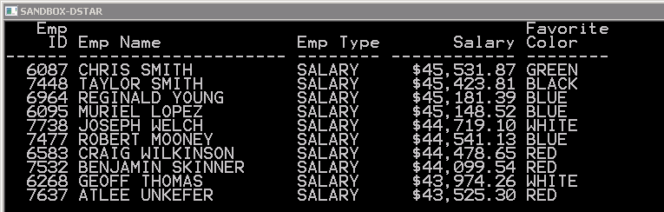
SQLPlus Formatting Example Script Output

